Slide 1
Walk-in Token
Zombies--The Idea Pitch

Slide 2
Table of Contents
Current SafeEntry Token features
Improvements we made
Reasons for the change
Done by Arwen
Done by Maisie
Done by Nusrat
The Code
Demonstration
Done by Adam
Done by Rachel

Slide 3
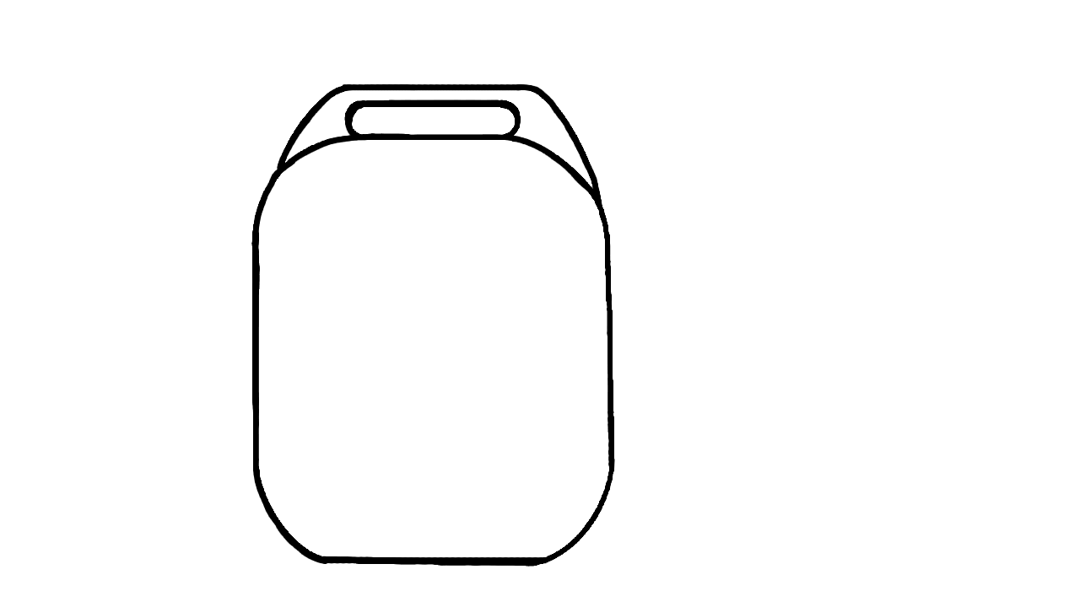
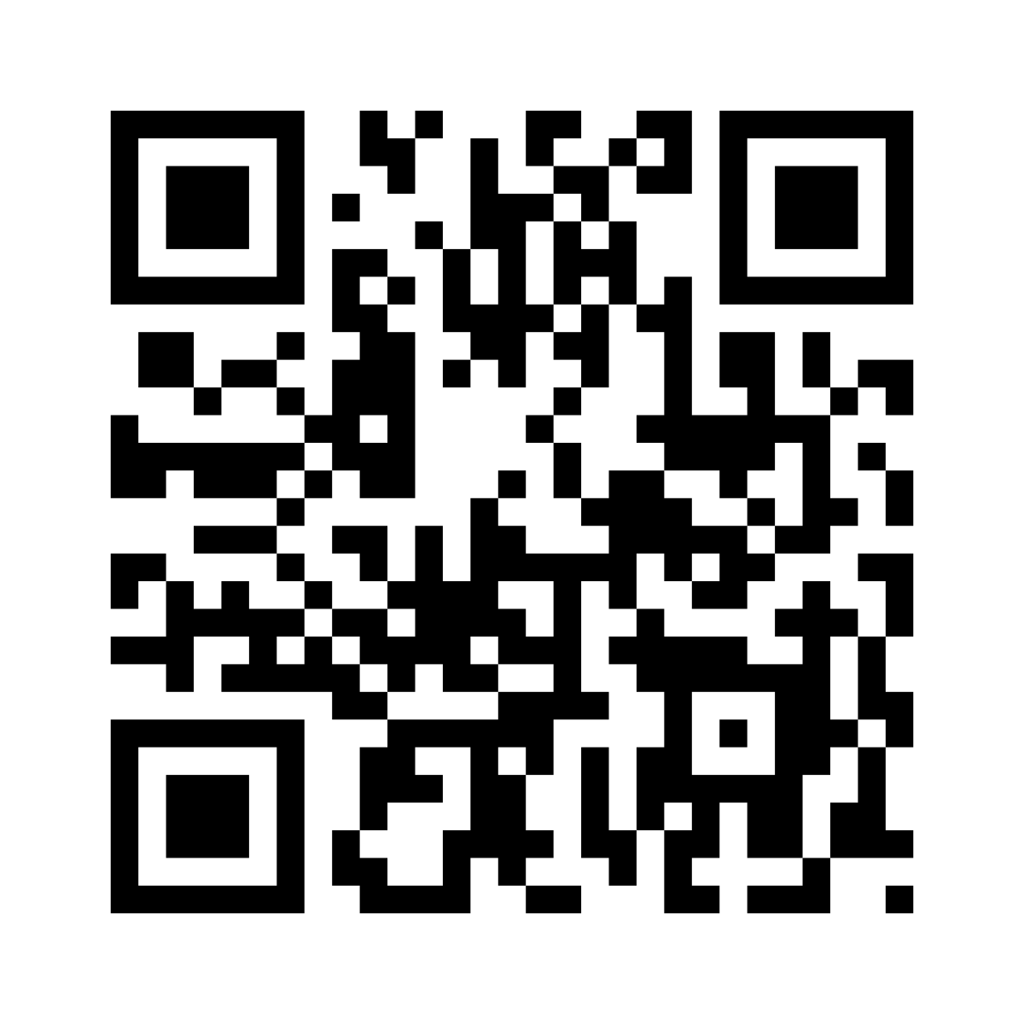
The Current features of the SafeEntry Token
Capture proximity data via bluetooth technology and does not capture GPS / geolocation data
Doesn’t have internet / cellular connectivity
Bluetooth data stored only on the Token
Data deleted in your device after 25 days

Slide 4
How did we improve the features?
Originally, we would need to have the token on hand in order to SafeEntry check-in
Now, just being in the proximity of the RFID scanner will allow you to SafeEntry check-in
Notes:
With our current SafeEntry token, we either manually check in or we had to tap in at the safe entry gateways. This makes it inconvenient for us, especially when we are carrying groceries and have our hands full.
With our improvements, being in the range of the rfid scanner would automatically check us in without the hassle of taking out our phone or token.

Slide 5
Why implement these changes?
for CONVENIENCE ;
Most people find it a hassle to Safe Entry
Some people find it difficult to find their token
Or some people find it annoying to turn on their bluetooth on their phone as an alternative to the token
It drains their battery too
Sometimes a scanner is not available in the shops of the mall for example so we have to use our phone again and again
Some are even lazier not to Safe Entry at all!!

Slide 6
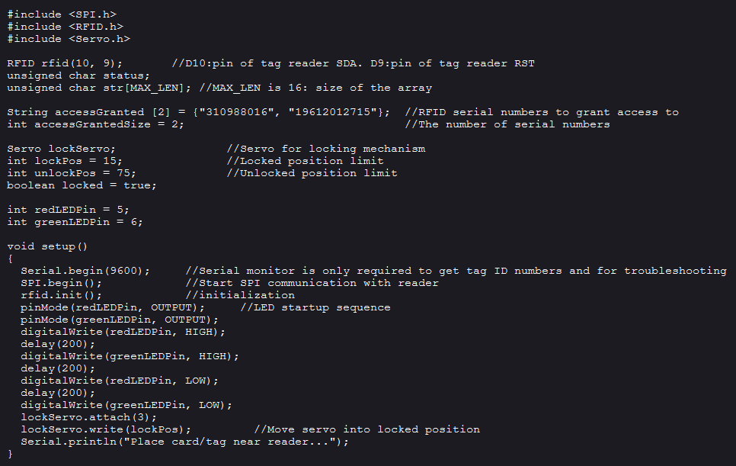
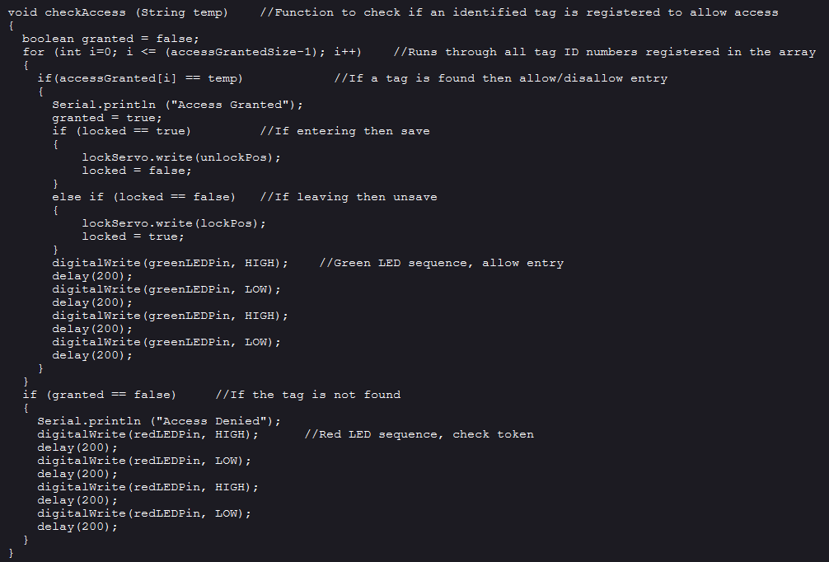
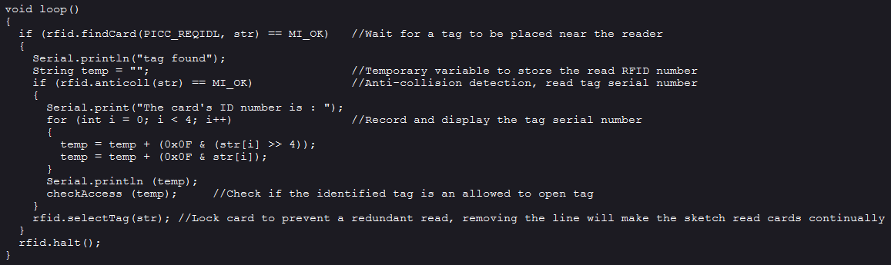
The Code (C Programming)

Slide 7
Demonstration
When you walk into a mall or shop, you don’t need to take out your token
The token has an RFID that is unique and can be detected by a scanner nearby
RFID means radio frequency identification
The “barcode” will store information
Information can be reviewed by scanning the “barcode”
So, how does it work?

